Slide 1


How Voice Service Threatens Cellular-Connected IoT Devices in the Operational 4G LTE Networks
Tian Xie¹, Chi-Yu Li², Jiliang Tang¹, Guan-Hua Tu¹
¹Michigan State University
²National Chiao Tung University
Notes:
Thank you for the introduction.
In this talk, we will introduce how voice service threaten cellular-connected IoT devices in the operational 4g lte networks

Slide 2

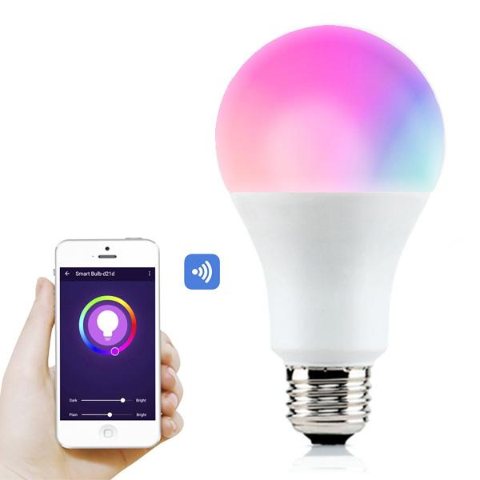
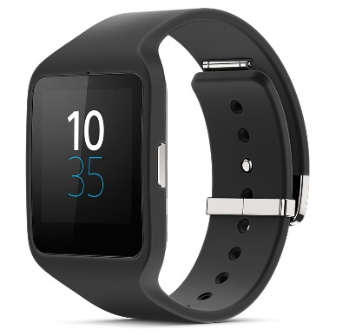
Internet-of-Things (IoT) Era
‘Things’ include a wide variety of devices
House appliances
Hotspot on vehicles
Wearable devices
Heart monitoring implants
Cameras streaming live feed of wild animals
Biochip transponders on farm animals
Etc.
https://appsec-labs.com/iot-security/
Notes:
Today, we are living in a IoT era.
IoT are transforming our lives, improving efficiency, availability and security of our environment and life.
This brings all of us connected over the Internet.

Slide 3
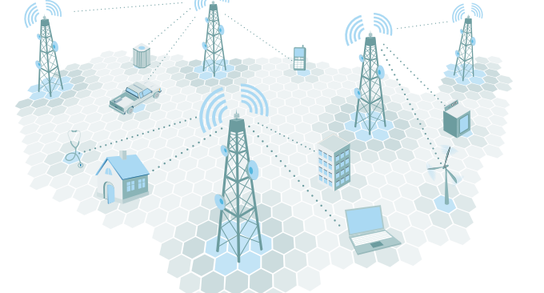
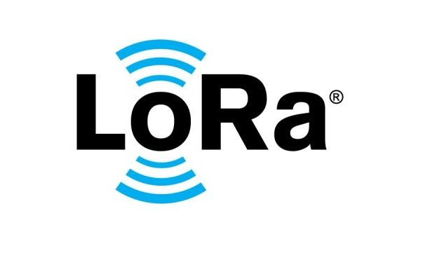

Cellular IoT
Non-Cellular IoT
Rel-8/ Cat. 4, Rel-8/Cat. 1, etc.
Providing wide range data rates (0.2 Mbps to 150 Mbps) with low-power consumption for IoT devices.
Already being proposed in 4G LTE networks and can be merged with existing networks
LoRA, SigFox, etc.
Only for low-speed transmission ( <= 50 Kbps) and low-power consumption IoT services.
Notes:
There are two categories of IoT devices. One is cellular IoT. Another is non-cellular IoT.
The typical cellular IoT contains Cat. 4, and Cat. 1…
(After talking about the information in the slides)
In this work, we focus on the cellular IoT. It is not only that cellular IoT devices will reach 1.5 billion in 2021 with an annual growth rate of 24.6%, but also Major U.S. cellular network operators including Verizon, ATT, and T-Mobile have launched cellular IoT services based on Rel-8/ Cat. 4, one of the most popular ones for wearable devices, car-connected hotspots, etc.

Slide 4
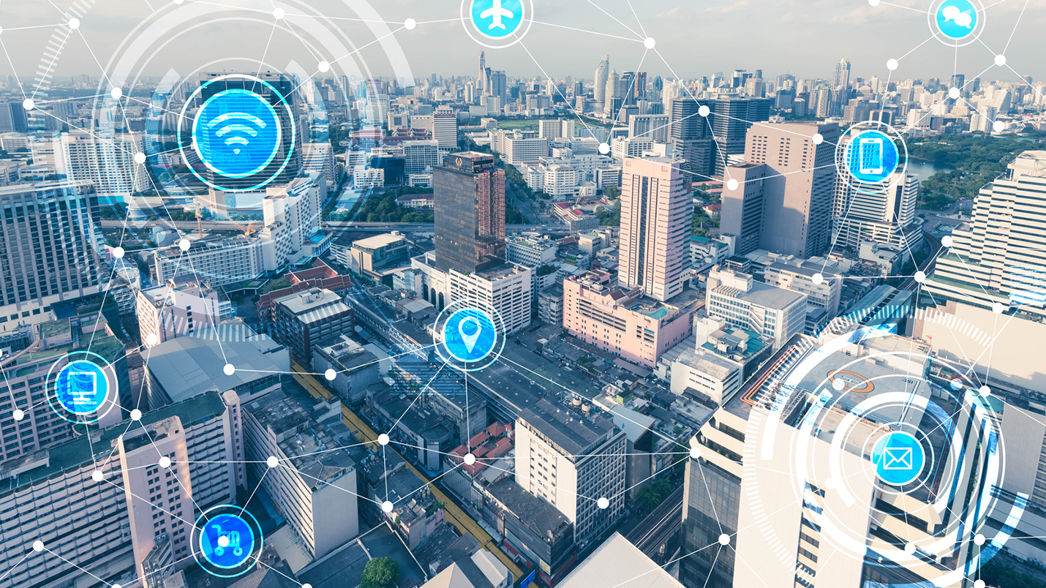
Key Problem for Cellular IoT Services
Does the existing network infrastructure support IoT services well?
Notes:
Since the cellular IoT services work on the existing 4G LTE network, there will be a critical question:
Does the existing network infrastructure serving conventional non-IoT devices be able to well support those low-profile IoT devices?

Slide 5
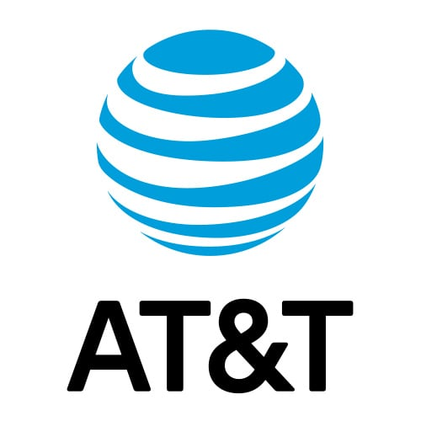
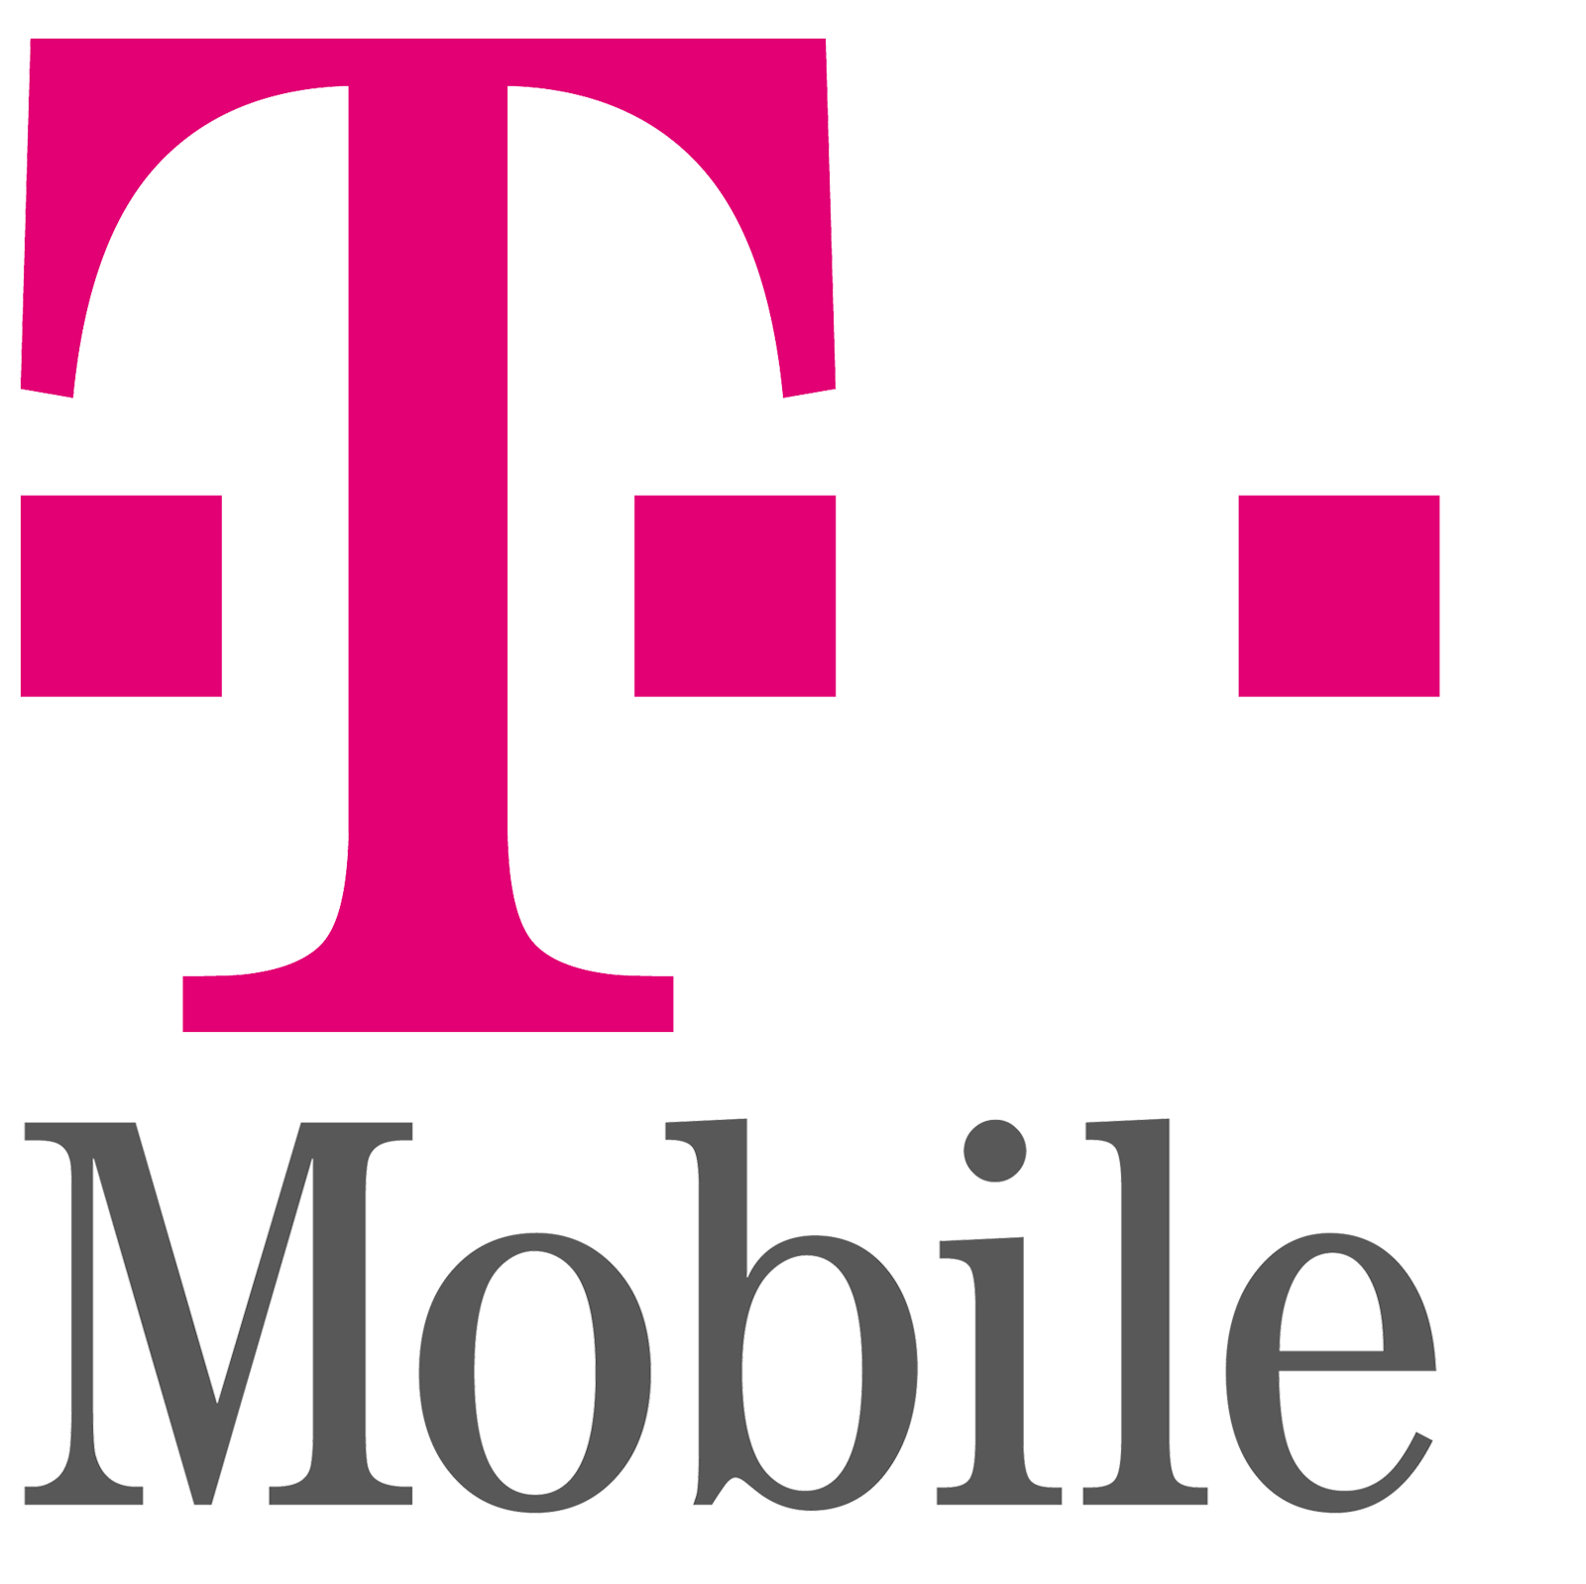
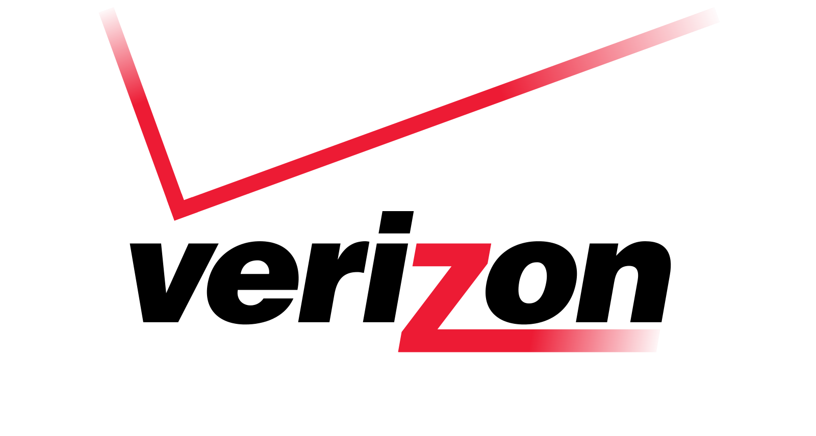
Glance of Cellular IoT
Cellular IoT devices share the similar network architecture with non-IoT devices (smartphones).
Specific IoT cellular network specification.
Notes:
To answer this question, let’s take a glance of cellular IoT service.
(Read two)
Everything looks no problem by our first glance. However, We found that there is a critical vulnerability on cellure IoT, which is caused by that IoT devices do not work as well as non-IoT devices!

Slide 6
Study of IoT Support in Cellular Networks
Cellular IoT Primer
Cellular IoT Architecture
IoT Specifications
Vulnerability
Proof-of-concept Attack
Solution
Notes:
Next, In this work, we demonstrate the study of IoT support in cellular networks.
Four main parts about our study are covered, which are …., respectively.

Slide 7
4G LTE Network Architecture for Cellular IoT
Radio Access Network (RAN)
Core Network (CN)
Management
Control
Data
Notes:
4G LTE consists two major components: RAN and CN.
RAN offers various radio specifications to the diversified IoT devices (car connected devices, smart meters, etc.)
Core Network has three planes, which are Management plane, Control plane, and Data plane.

Slide 8
4G LTE Network Architecture for Cellular IoT
Management Plane
Charging Gateway Function (CGF)
Billing System
Notes:
Charging Gateway Function and Billing System are used to account for the service amounts consumed by mobile devices and generate their bills. Traffic is reported by 4g gateways

Slide 9
4G LTE Network Architecture for Cellular IoT
Control plane
Home Subscriber Server (HSS)
Mobility Management Entity (MME)
Notes:
HSS records the IoT devices’ services.
MME administrates mobility, authentication, and resource reservation

Slide 10
4G LTE Network Architecture for Cellular IoT
Data plane
CN connects RAN, IMS, and Internet
Notes:
It relies on 4G gateways to forwarding packets between the RAN and IMS, and the packets between RAN and Internet, to serve IMS services and the Internet access.
As a result, we can see that the 4G LTE Network architecture for cellular iot is similar to the network architecture for non-iot.

Slide 11
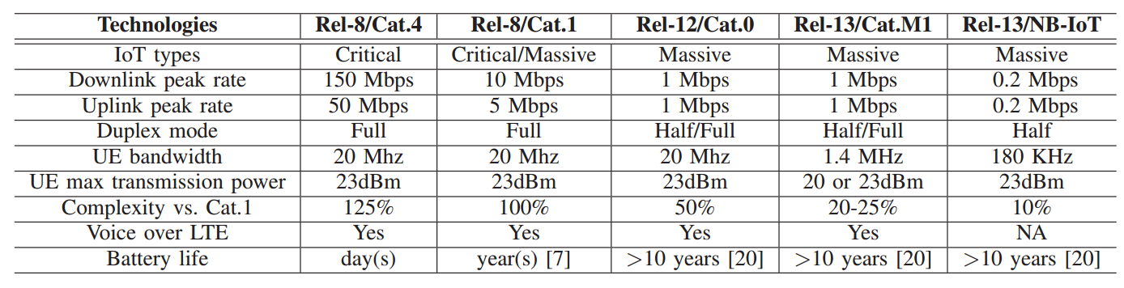
Cellular IoT Technologies in 4G LTE
Various network specifications in the 4G LTE network for diverse demands from IoT services
Widely used
Newly launched
Notes:
After reviewing the network architecture, next I’ll introduce the cellular IoT technologies in 4g lte.
Here we have two IoT types. Critical applications: traffic/safety control, which requires ultra reliability, low latency, high availability
Massive ones: smart agriculture, which focuses on low cost, low energy, and small data volumes
Rest: is projected to be launched in the following years

Slide 12
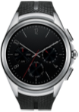
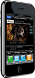
Vulnerability
Conventional charging function operates on a per-bearer basis.
Time-based charging
VoLTE voice
4G Gateway
4G Gateway
VoLTE voice & mobile data services
Mobile data services
Smartphone
Volume-based charging
Smartwatch
Notes:
For the smartphone on 4g lte network, it can have multiple bearers for different purposes. For example, we can create one bearer for…
For different services, there are different charging mechanisms: time-based, volume-based
However, IoT devices may have hardware limitation that only one bearer can be supported or IoT devices are unable to always keep multiple bearers. Normally, a single bearer of IoT device may server both VoLTE service and mobile data services. Without carefully examining the charging functions for IoT devices, this vulnerability may cause the monetary loss.

Slide 13
Improper IoT Service Charging Function
Same experiment location
Network Interface
Only one network interface
Two network interfaces
Notes:
Next, we show the vulnerability in our real life.
These are two screen captures of the network interface of our test smartphone and smartwatch in the experiment conducted in the same location.
A VoLTE-enabled smartphone usually maintains two bearers: one for mobile data service, another for VoLTE signaling messages.
In our test smartphones, two network interfaces are created for data and VoLTE bearers. (click)
For test smartwatches, they can’t always keep multiple network interfaces on. Only one interface is observed on the smartwatch, which can support both data and VoLTE services.

Slide 14
Improper IoT Service Charging Function
Question: Which charging function is used on the smartwatch?
Currently, the service plan for IoT devices provided by operators is volume-based charging.
This bearer’s charging method is volume-based. Thus, the VoLTE service will be charged too. (VoLTE signaling is not free!)
Notes:
So, it should be a question, which charging function is used on the smartwatch when the smartwatch relies on a single bearer to serve both the data and VoLTE service, the services will be assigned one charging method, either volume-based or the time-based scheme. (click, click)
When VoLTE signaling is not free in terms of traffic volume, signaling spams can cause mobile users to be overcharged.

Slide 15
Proof-of-concept Attack
Launch an IoT overcharging unaware attack by sending a large number of VoLTE call signaling spams
Without receiving SIP Update, the callee does not ring.
Notes:
After we show the vulnerability, next I’ll introduce our proof-of-concept attack.
(In this attack, ….)
In order to prevent the victim’s smartwatch from ringing during the attack, the attack calls need to be carefully manipulated to terminate right before the event before trigging the play of victim’s ringtone.
(click)
Here is a simplified VoLTE call flow.
To provide good service quality, VoLTE service needs to reserve the resource before the call. Therefore, the attack can use it to send signaling spams without ringing.

Slide 16
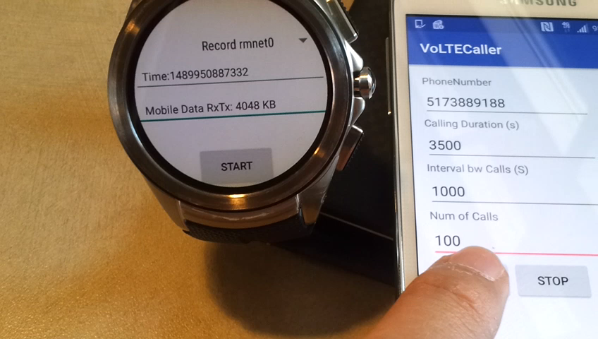
Proof-of-concept Attack
Use our previous developed application, VoLTECaller, to launch the attack.
Interrupt the dialing when observing SIP Session Progress





Notes:
VoLTECaller is previous designed to silently drain the smartphone batteries of victims and suffocate their data service.
In this attack, we use VoLTECaller to make a VoLTE call towards the victim and then interrupts the dialing right after observing the SIP SESSION PROGRESS.

Slide 17
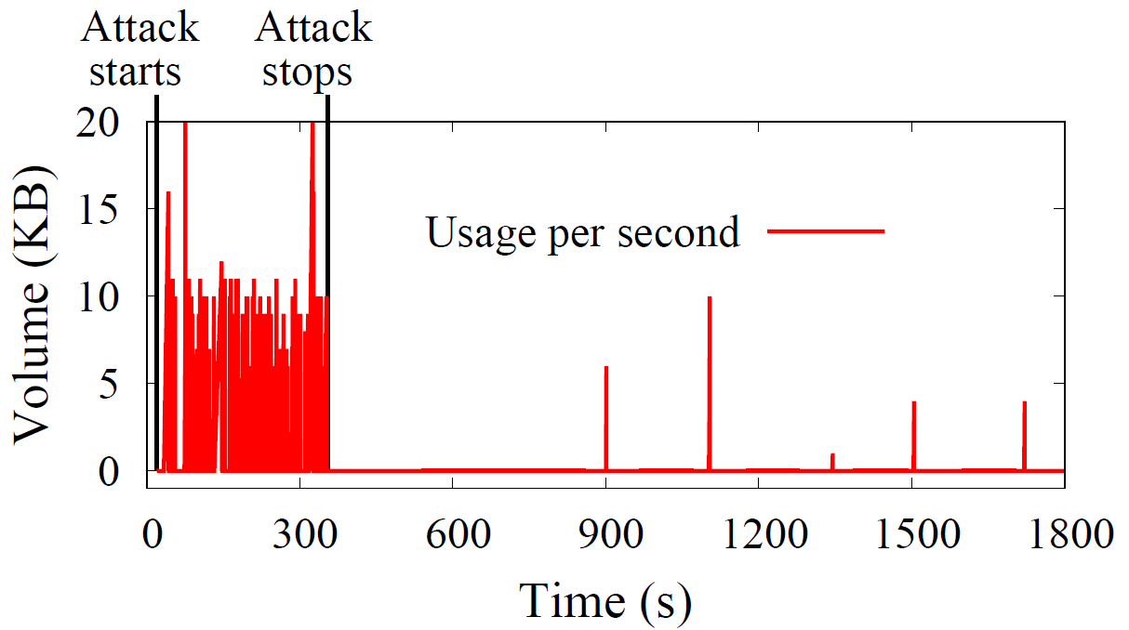
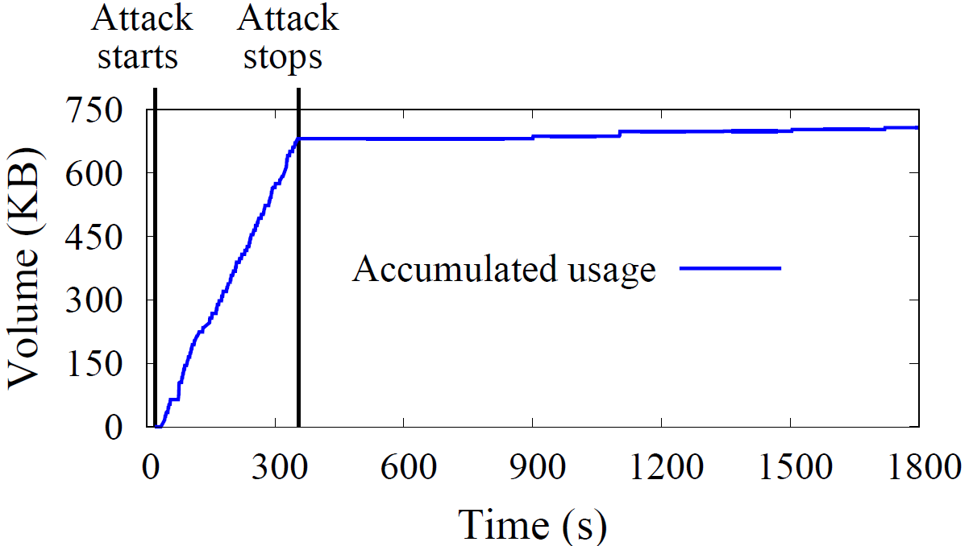
Attack Result
Data usage volume per second
Accumulated data usage volume per second
Each VoLTE call attempt: 3.24 seconds
Total data consumed: 681 KB
177 MB
Notes:
This is our proof-of-concept attack result.
We use VoLTECaller to place 100 VoLTE calls from our VoLTE-enabled smartphone to our test smartwatch and record the data usage of the smartwatch.
(click)
From our experiments, 3.24 seconds are averagely required by each call attempt.
In these 100 VoLTE calls, 681 KB data is consumed.
(click)
If the attack lasts for a day, it will cause the victim to be overcharged around 177 MB.

Slide 18

Real World Impact?
Verizon provides a cellular IoT charging plan for IoT users ($2 for one device with 200 KB data.
The attack can consume 681 KB in 324 seconds, which means that 200KB data can be used in 100 seconds.
No automatically refill: Denial of service
Automatically refill: Non-negligible financial loss
$2 per 100 seconds = $1440 per day for a single IoT device!
Notes:
Under this attack, the victim may suffer two losses depending on whether the victim sets the automatically refills for IoT devices.
Denial of service: when the IoT device under the attack doesn’t refill the service plan, it will stop work because it cannot send and receive any data packets.
Non-negligible financial loss: If the victim set the automatically refilling for his/her IoT device, his/her bill(click) will increase $2 per 100 seconds, which is $1440 per day for only a single IoT device.

Slide 19
Solution
Flow-based service charging method for IoT devices.
Service data flow is identified by the five-tuple information:
Source IP address or mask
Source port number
Destination IP address or mask
Destination port number
Protocol ID (TCO/UDP)
VoLTE signaling can be represented (*, *, VoLTE_Server_IP, 5060, TCP)
Notes:
Carriers can define a set of flow rules for each service and then apply a charging policy to the set.

Slide 20
Solution
Advantage of flow-based charging method
Compatible: Applying different charging methods to a single bearer for different services
Deployable: T-Mobile and Verizon provide users with free DNS services (packets over TCP/UDP destination port 53 are free of charge)

Slide 21
CONCLUSION
Review the network architecture and specification for cellular IoT
Vulnerability
The single bearer of IoT device servers both VoLTE services and data services.
Proof-of-concept attack
Solution
Flow-based service charging method

Slide 22
Thank you! Questions?

